Slide 1
Topic: Algebra
EQ: How do we add like terms and substitute variables?

Slide 2
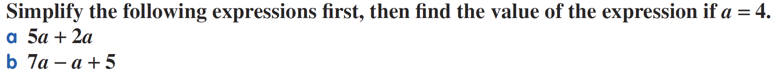
Entry Pass- on whiteboards
“Evaluate this expression”= Finding the value of an expression

Slide 3
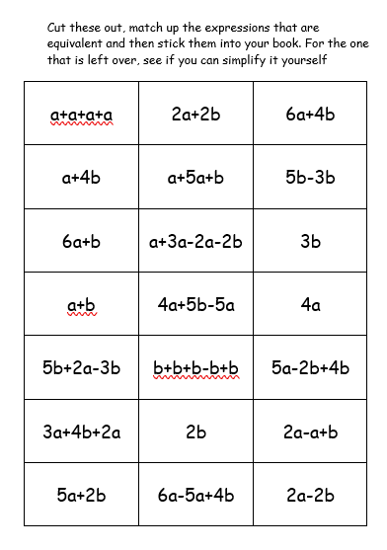
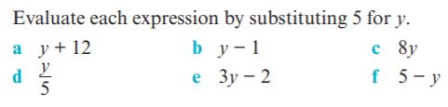
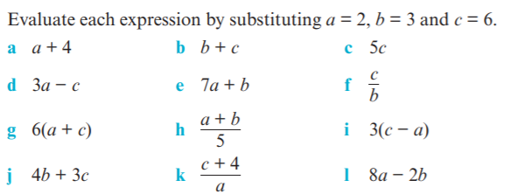
Activity 1
Activity 2
Showing the three steps of working out complete the following in your INB
1.
2.

